Slide 1
1.1.2 Histograms
AP Statistics

Slide 2
Histograms Vs. Bar Graphs
Histogram – shows the distribution of counts or percents among values of a single quantitative variable; (no spaces to show all values are being covered)
Bar Graph – displays the distribution of a categorical variable; (spaces between bars)

Slide 3
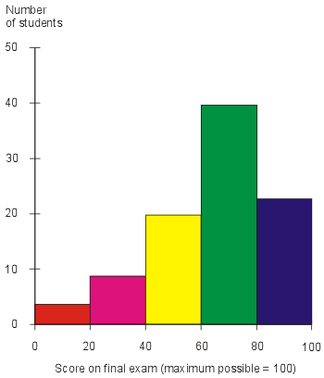
Definition
Histogram – Breaks the range of values of a variable into classes and displays only the count or percentage of the observations that fall into each class.
Preferred for large data sets

Slide 4
Histograms
Step 1: Divide the range of the data into classes of equal width. Count the number of observations in each class. Be sure to specify the classes precisely so that each observation falls into exactly one class
Step 2: Label and scale your axes and title your graph. Label the horizontal axis and vertical axis
Step 3: Draw a bar that represents the count in each class. The base of a bar should cover its class, and the bar height is the class count. Leave no horizontal space between the bars (unless a class is empty so that its bar is at 0.

Slide 5
Histogram Tips
Tip 1: There is no one right choice of the classes in a histogram. Too few classes will give a “skyscraper” graph whereas too many will provide a pancake graph. Neither choice will give a good picture of the shape of the distribution
Tip 2: Five Classes is a good minimum
Tip 3: Our eyes respond to the area of the bars in a histogram, so be sure to choose classes that are all the same width. Then the area is determined by height and all classes are fairly represented.
Tip 4: If you use a computer or graphing Calculator, beware of letting the device choose the classes.

Slide 6
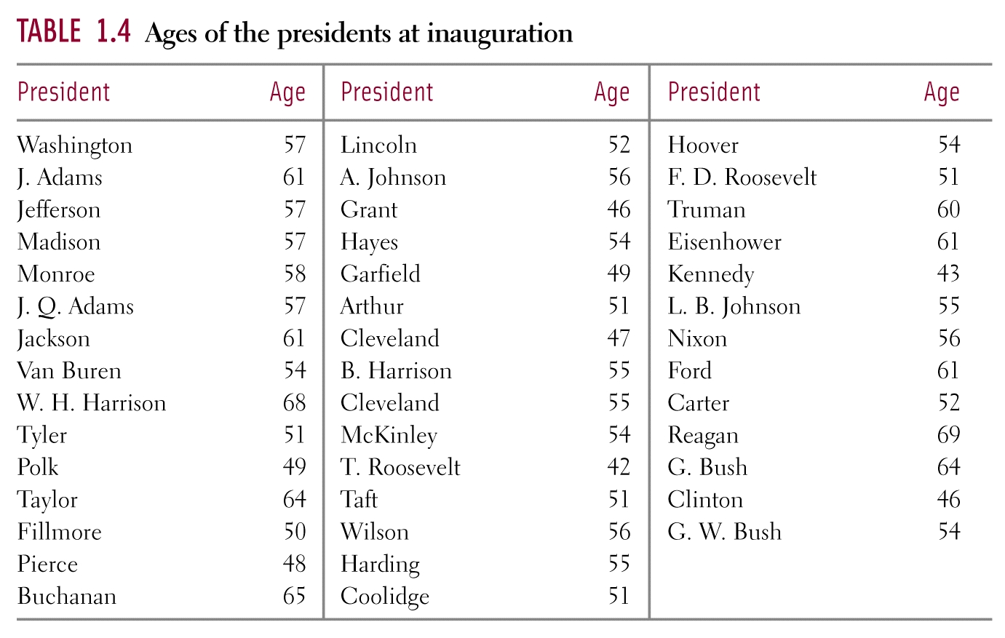
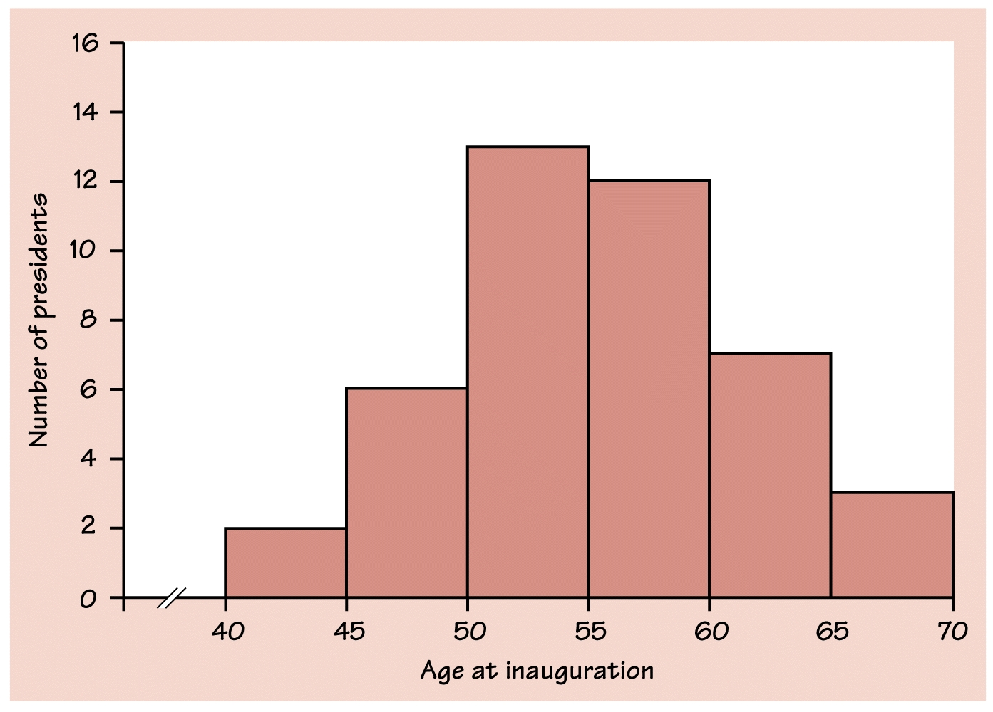
Table 1.4 page 57 How old are presidents at their inaugurations? Was Bill Clinton, at age 46 unusually young? Table 1.4 Gives the data, the ages of all US presidents took office. After Reviewing the histogram, describe the distribution.

Slide 7
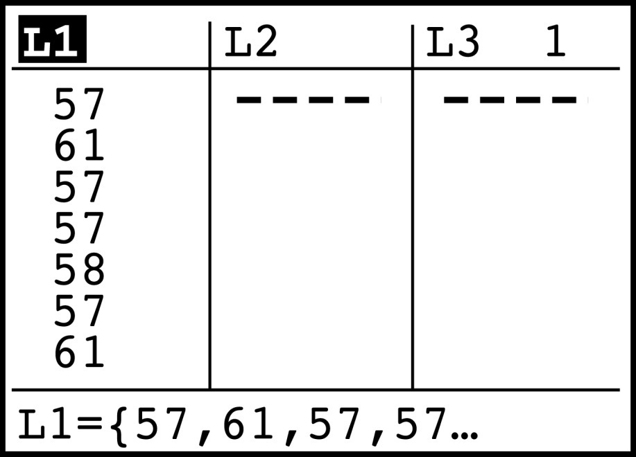
Histograms on the Calculator
Pres STAT and then EDIT
Put the president’s ages in to list 1

Slide 8
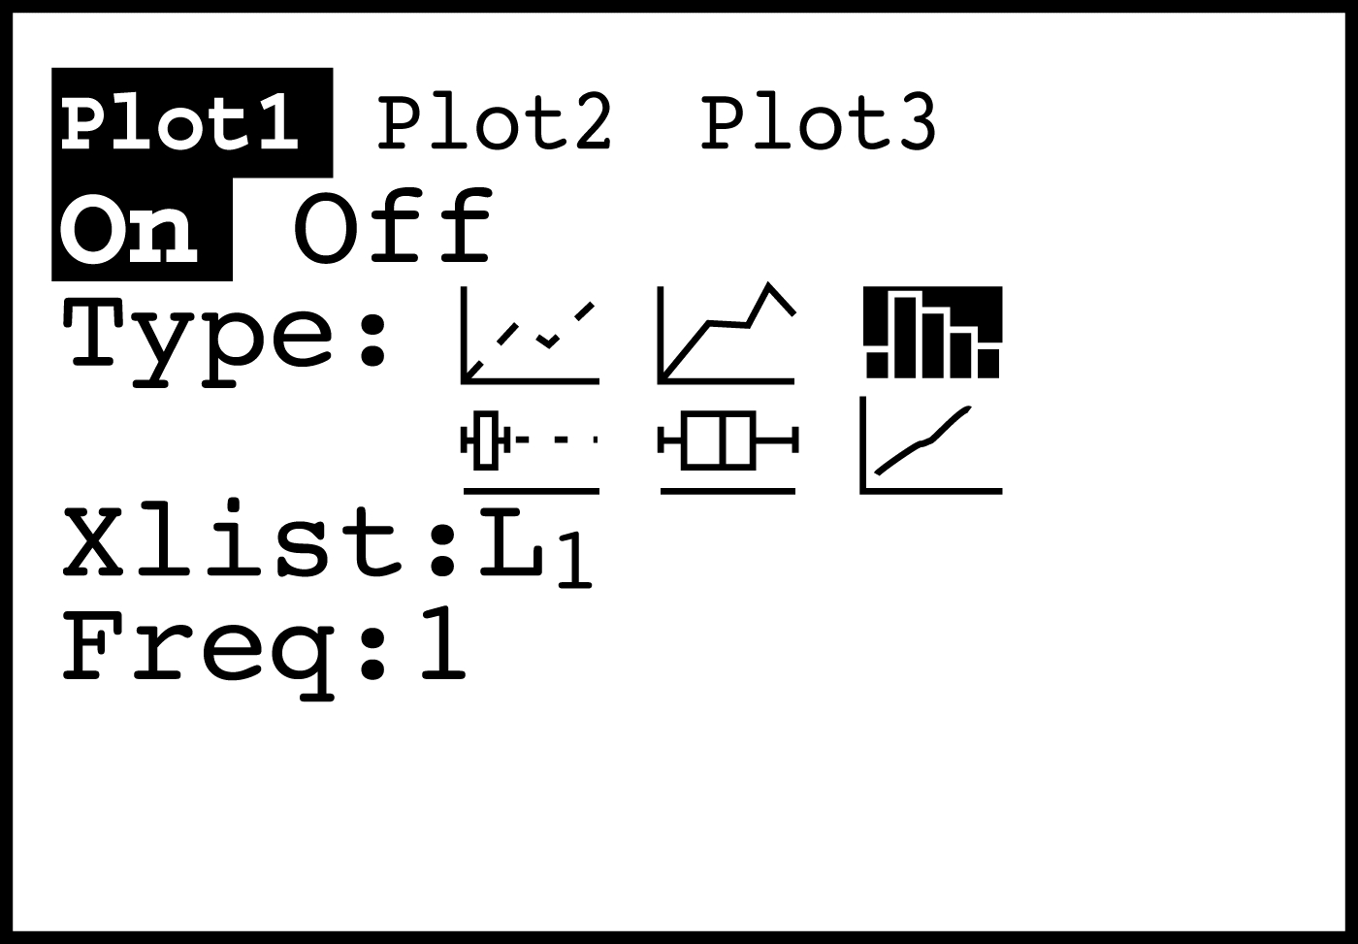
2nd , Y=, Select Plot 1 and set Plot 1 as follows:

Slide 9
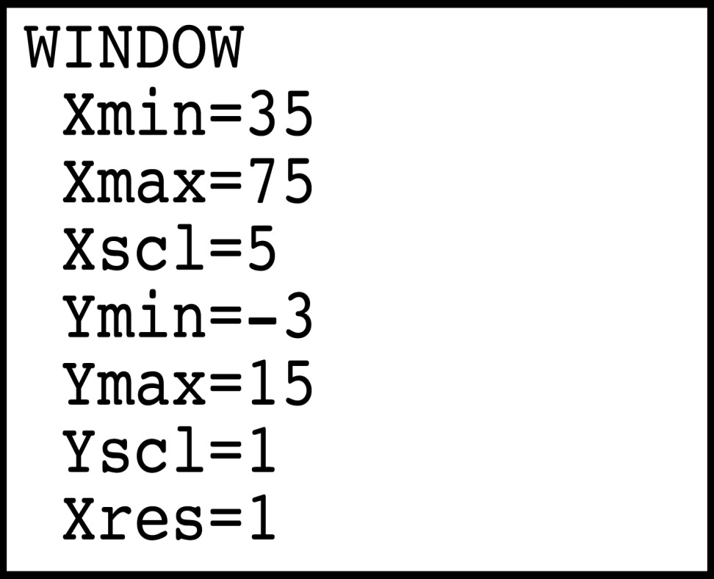
Now Lets Change our Window. We want classes of equal length that contain the entire spread. Lets use the classes on our books histogram.
Press GRAPH
Press WINDOW

Slide 10
Homework
pg. 68 # 1.25 - (Show the histogram by hand making sure you label properly, then try it in your calculator)
Pg. 69 # 1.26
Read Pages 60-63 on Relative & Cumulative Frequencies and on Time Plots. Enter the important information into your notes
* Work on your Ch. 1 NTG (posted online)

